Slide 1

MITRE ATT&CK matrix y reglas out-of-the-box para syscalls

Slide 2
Recomendaciones MITRE ATT&ACK

Slide 3
MITRE ATT&ACK enterprise matrix
Mitre Corporation: organismo sin ánimo de lucro financiado por el gobierno federal de EEUU para dar soporte a varias de sus agencias gubernamentales.
MITRE ATT&ACK
https://attack.mitre.org/
Tactics
Techniques / Subtechniques
Matrices

Slide 4
Falco MITRE Rule Matrix
Execution | Persistence | Privilege Escalation | Defense Evasion | Credential Access | Discovery | Lateral Movement | Exfiltration
DB program spawned process | Modify Shell Configuration File | Launch Privileged Container | Clear Log Activities | Read sensitive file trusted after startup | Read Shell Configuration File | Launch Privileged Container | System procs network activity
Run shell untrusted | Schedule Cron Jobs | Non sudo setuid | Delete Bash History | Read sensitive file untrusted | Read ssh information | Launch Sensitive Mount Container | Interpreted procs inbound network
Terminal shell in container | Update Package Repository |  |  | Search Private Keys or Passwords | Read sensitive file untrusted | Launch Disallowed Container | Interpreted procs outbound network
Netcat Remote Code Execution in Container | Write below binary dir Write below monitored dir |  |  |  | Contact K8S API Server From Container |  | Unexpected UDP Traffic
 | Write below etc Write below root Write below rpm database |  |  |  | Launch Suspicious Network Tool in Container |  | Launch Suspicious Network Tool in Container
 | Modify binary dirs Mkdir binary dirs |  |  |  | Launch Suspicious Network Tool on Host |  | Launch Suspicious Network Tool on Host
 | User mgmt binaries
 | Create files below dev
 | Launch Package Management Process in Container
 | Remove Bulk Data from Disk Set
 | Create Hidden Files or Directories
 | Setuid or Setgid bit
https://sysdig.com/blog/mitre-attck-framework-for-container-runtime-security-with-sysdig-falco/

Slide 5
Otros estándares de seguridad: NIST, PCI, CIS

Slide 6
PCI
Payment Card Industry (PCI)
PCI Security Standards Council (PCI SSC) pcisecuritystandards.org
PCI Data Security Standard (PCI DSS)
https://es.pcisecuritystandards.org/index.php

Slide 7
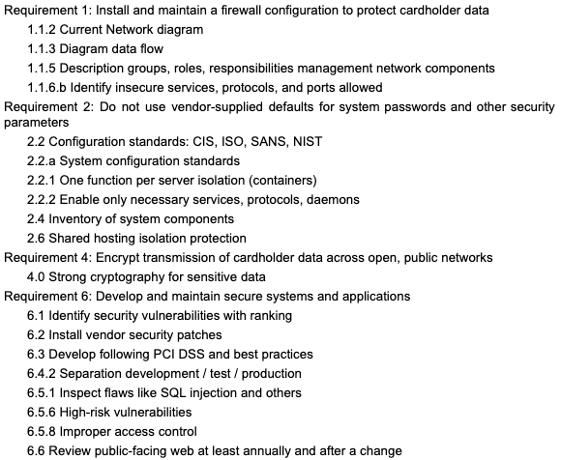
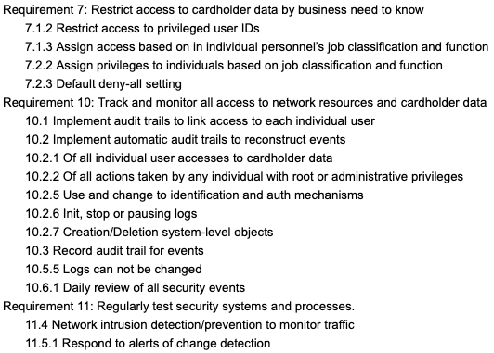
PCI
sysdig.com/resources/whitepapers/a-guide-to-pci-compliance-in-containers-and-kubernetes

Slide 8
NIST
National Institute of Standards and Technology (NIST)
NIST 800-190 https://nvlpubs.nist.gov/nistpubs/SpecialPublications/NIST.SP.800-190.pdf
NIST 800-53 https://nvd.nist.gov/800-53 Más de 500 controles de seguridad

Slide 9
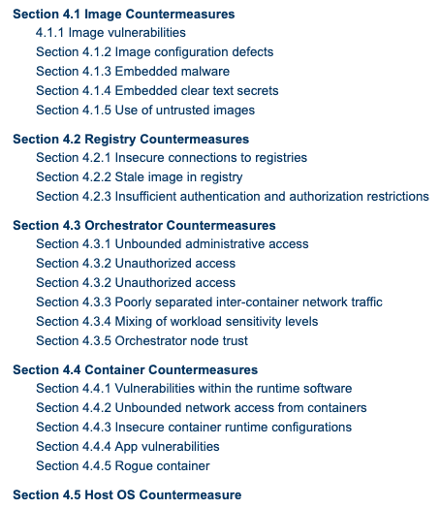
NIST 800-190

Slide 10
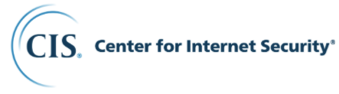
www.cisecurity.org
Linux Benchmark
Docker Benchmark
Kubernetes Benchmark
https://www.cisecurity.org/cis-benchmarks/
Notes:
We are a community-driven nonprofit, responsible for the CIS Controls® and CIS Benchmarks™, globally recognized best practices for securing IT systems and data. We lead a global community of IT professionals to continuously evolve these standards and provide products and services to proactively safeguard against emerging threats. Our CIS Hardened Images® provide secure, on-demand, scalable computing environments in the cloud.
CIS is home to the Multi-State Information Sharing and Analysis Center® (MS-ISAC®), the trusted resource for cyber threat prevention, protection, response, and recovery for U.S. State, Local, Tribal, and Territorial government entities, and the Elections Infrastructure Information Sharing and Analysis Center® (EI-ISAC®), which supports the rapidly changing cybersecurity needs of U.S. elections offices.

Slide 11
Otros estándares de seguridad
System and Organization Controls (SOC)
AICPA, aicpa.org/interestareas/frc/assuranceadvisoryservices/aicpasoc2report.html
Designed for service providers storing customer data in the cloud
Customized to each company
Health Insurance Portability and Accountability Act (HIPAA)
hhs.gov/hipaa/for-professionals/security/laws-regulations/index.html
(UE) General Data Protection Regulation (GDPR)
gdpr-info.eu

Slide 12
Aportando reglas al proyecto Flaco

Slide 13
Para enviar una nueva regla a Falco
Crear un ticket en el repositorio de Falco para discutir la idea de la necesidad de la regla
Configurar firma gpg con git y github https://docs.github.com/en/free-pro-team@latest/github/authenticating-to-github/signing-commits
Crear un fork del repositorio https://github.com/falcosecurity/falco
Añadir la regla nueva en falco_rules.yaml
Hacer commit con las opciones -s -S
Enviar Pull Request hacia el repo principal, indicando el ticket
Comentarios de Pull Request: aceptar condiciones de uso de la Cloud Native Computing Foundation

